Slide 1
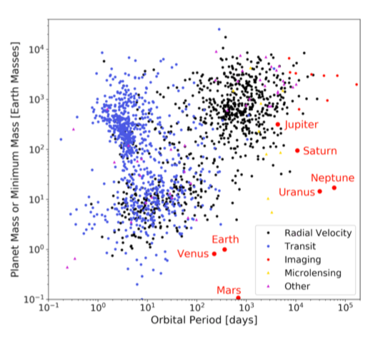
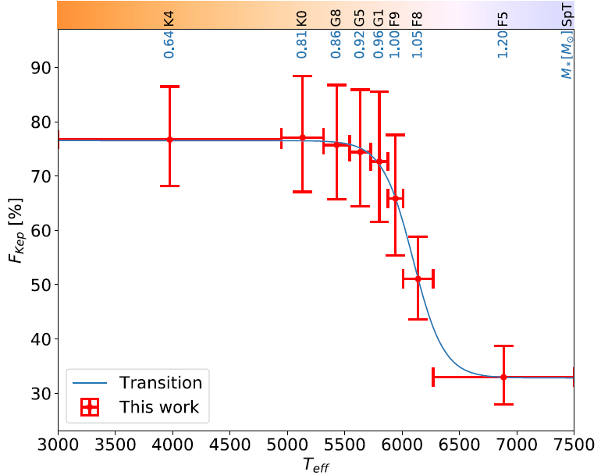
Exoplanet Demographics in the 2050s:
How Does GaiaNIR Fit In?
Alessandro Sozzetti
(INAF – Osservatorio Astrofisico di Torino)

Slide 2
Overarching Questions
Planetary Systems Formation:
a) How do planets and planetary systems form? b) Which features (spirals, gaps) of protoplanetary disks trace unambiguously ongoing planet formation? c) Where (which snowlines) and how (planetary accretion history) do planets grow ?
Planetary Systems Demographics:
What is the diversity of planets and planetary system architectures? How common are true Solar System analogs? Where are the nearest Earth-like planets? How do the architectural and physical properties of planetary systems depend on stellar and environmental properties?
Planetary Systems Characterization:
What are exoplanets made of? What is the chemistry and dynamics of their atmospheres?
Can we find evidence for biological activity? Can we understand habitability?
See also ASTRONET Roadmapping exercise final report with the analysis of the
Panel on Planetary Systems Formation and Evolution available at:
https://www.astronet-eu.org/?page_id=521

Slide 3
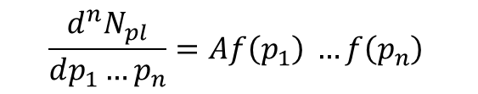
What is Demographics?
TRENDS, CORRELATIONS OF OCCURRENCE RATES WITH:
Mass
Radius
Density/Composition
Orbital Radius/Period
Habitable Planets and eta-Earth
Planet Multiplicity
Eccentricity
Host Star Properties (Mass, Age, Composition, Binarity)
$$\frac{d^{n}N_{pl}}{dp_{1}…p_{n}}=A{f\left(p_{1}\right)}^{ }…{f\left(p_{n}\right)}^{ }$$
WARNING!
Accounting for:
- Completeness (missing planets)
- Reliability (false positives)
- Incorrectness (of orbits)
NOT TRIVIAL!
Distribution functions retain imprints of planet formation and evolution processes

Slide 4
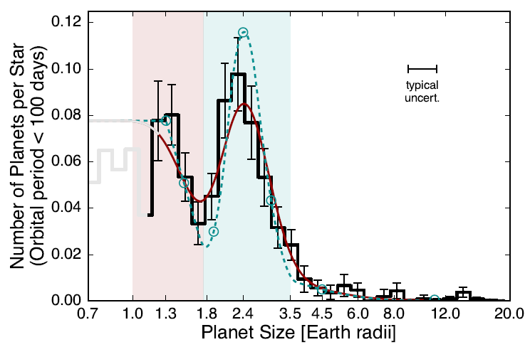
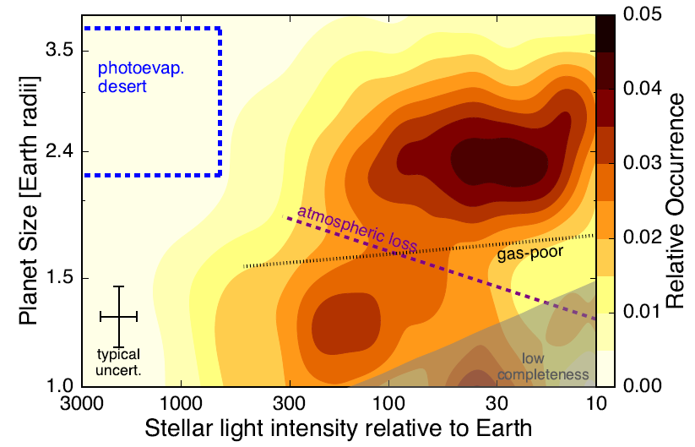
Radius Distribution
Fulton et al. 2018
Clearly bimodal: Radius ‘Valley’ or ‘Gap’
The gap in the planet size distribution separates two classes of small planets:
a) rocky super-Earths (pink) and
b) volatile-rich or/ gas-dominated sub-Neptunes (light blue).
A direct evidence of evolutionary processes (photoevaporation) of planetary systems

Slide 5
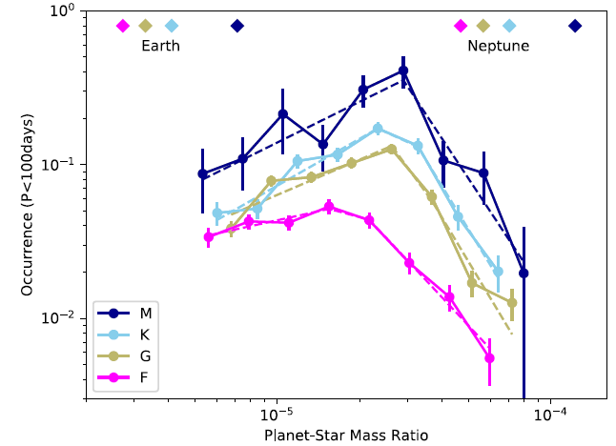
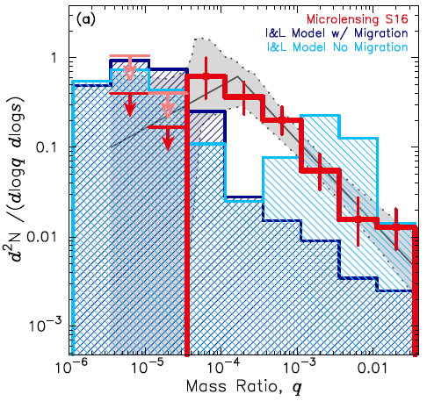
Mass Distribution
Pascucci et al. 2018
Suzuki et al. 2018
a > 2 au
P< 100 days
Is the possible break (for close-in planets) a universal feature?
Is mass ratio the most fundamental quantity?
Are cool sub-Saturn-type planets more common than expected?

Slide 6
Same technique, different surveys:
Different answers!
Separation Distribution
Giant planet frequency declines beyond the snowline
Or does it?
Lagrange et al. 2023
Fulton et al. 2021

Slide 7
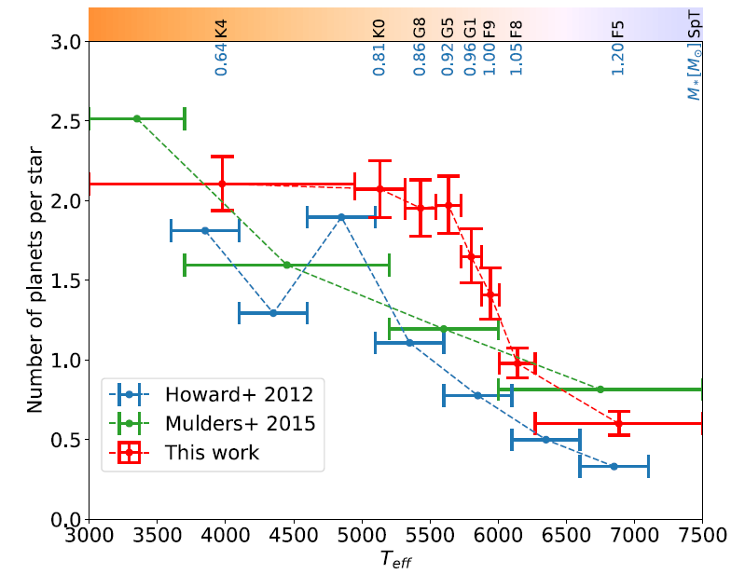
The Planet-Star
Connection (1)
P < 100 days
Yang et al. 2020
What is the fraction
of stars with ANY
close-in planets?
P < 100 days
How many close-in
planets per star?

Slide 8
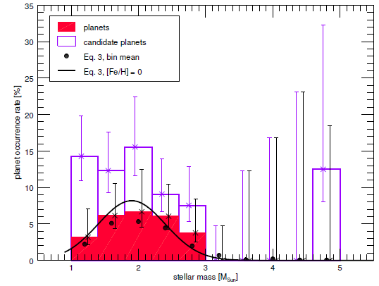
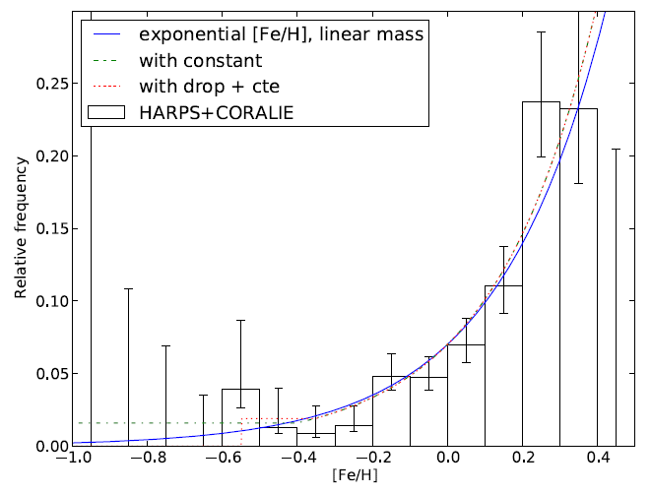
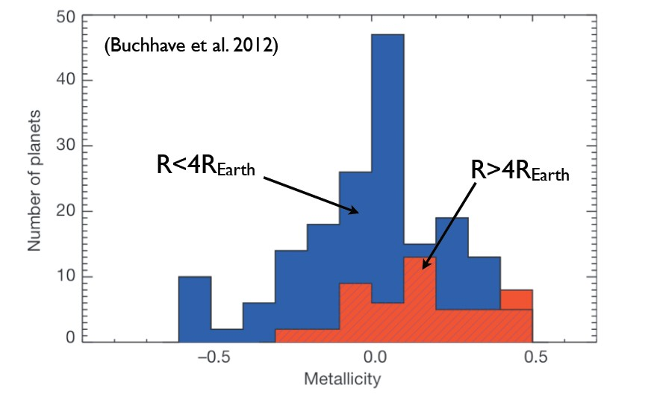
The Planet-Star Connection (2)
Giant planets
Johnson et al. 2010
F_{p} vs M*
Giant planets
a < 3-4 au
Reffert et al. 2015
P < 100 days
Giant planets
F_{p} vs [Fe/H]
Mortier et al. 2012

Slide 9
Young ages, wide separations
M= 1-75 M_{Jup}, a = 5-300 au
Vigan et al. 2021
Typically probing the high-mass tail of the planetary mass function
(or is it the low-mass tail of the brown dwarf mass function?)
- Confirmed trend of increasing frequency with stellar host mass

Slide 10
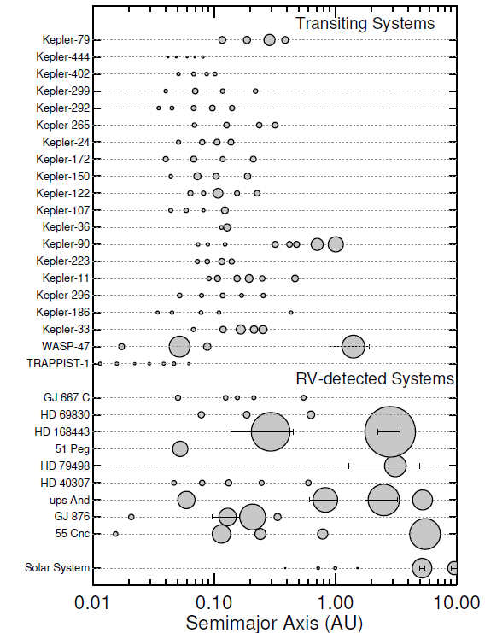
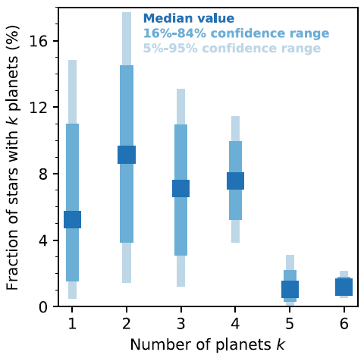
Multi-planet Systems
Zhu et al. 2018
Transiting multis are very
‘flat’ and compact systems,
with similar sizes
None yet like the Solar System!

Slide 11
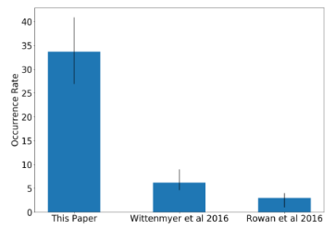
‘Ordered’ Architectures: Occurrence
Pinamonti et al. 2023
f(CJ/SE,N)
Bryan et al. 2019
Bonomo et al. 2023
Presence/Absence of CJ:
Different impacts on the existence of
SE/N as a function of stellar mass?
1) K7-M3 dwarfs: f(SE/CJ) < 64%, f(N/CJ) = 25%
2) F6-K5 dwarfs: f(CJ/SE,N) = 9%

Slide 12
Earth Twins:
Occurrence Rates
Kopparapu et al. 2013

Slide 13
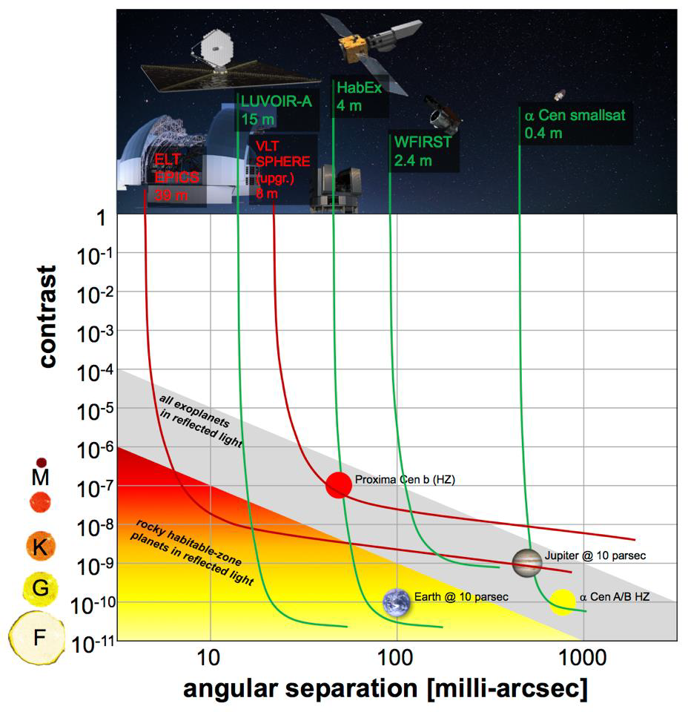
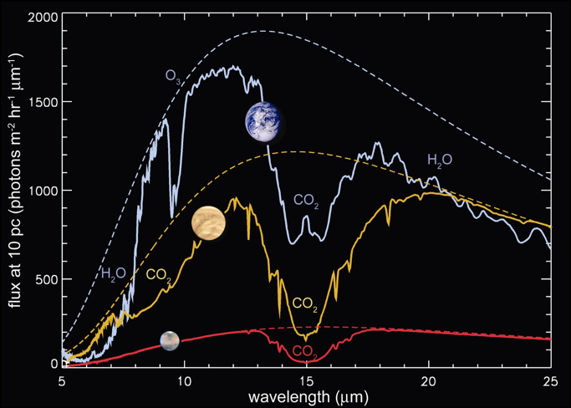
Earth-Like Planets: The Ultimate Frontier
Habitability and
atmospheric biosignatures of temperate terrestrial exoplanets
around the nearest solar-type stars
HWO
4-6m
Finding the targets FIRST
is mandatory in order to
maximize science return
True Earth twin: K = 9 cm/s

Slide 14
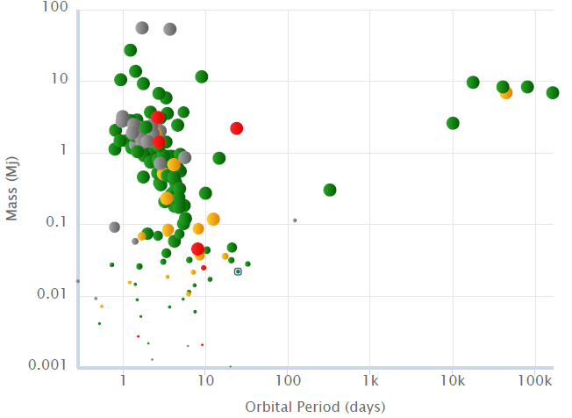
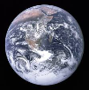
Atmospheres: Atoms & Molecules
Hic sunt dracones

Slide 15
Exoplanet Demographics:
Now, and Beyond
CURRENT:
Ground-based Transit Surveys
Kepler
Ground-based Microlensing Surveys
Direct detection Surveys
Credits:
C. Clanton, S. Gaudi

Slide 16
Exoplanet Demographics:
Now, and Beyond
FUTURE/WILL HAPPEN
TESS
Gaia
PLATO
Roman
NextGen EPRV
Credits:
C. Clanton, S. Gaudi

Slide 17

Exoplanet Demographics:
Now, and Beyond
FUTURE/MIGHT HAPPEN
Space-based Direct Imaging Missions?
Sub-10 cm/s EPRV?
Sub-𝜇as astrometry?
GaiaNIR
Credits:
C. Clanton, S. Gaudi

Slide 18
GaiaNIR - Impact
Cold giant planets around stars Gaia can hardly see (heavily
reddened young stars within 200-300 pc) or cannot see at all
(L and T dwarfs within 20 pc)
Detection of gas giants at Saturn-like distances, combined with Gaia:
the demographics of exoplanets at 5-10 au around solar-type stars is
still vastly unexplored/uncertain
First-ever estimate of the frequency of planetary systems with
BOTH Jupiters AND Saturns
Neptunes and Super Earths beyond the snowline around the
nearest low-mass M dwarfs (proper motion anomaly)

Slide 19
Planet Formation Around BDs
GaiaNIR Sensitivity:
- M = 35 M_{Jup}, L7 dwarf
(Luhman16A-like)
- J = 16 mag
- d = 20 pc
PCS@ELT

Slide 20
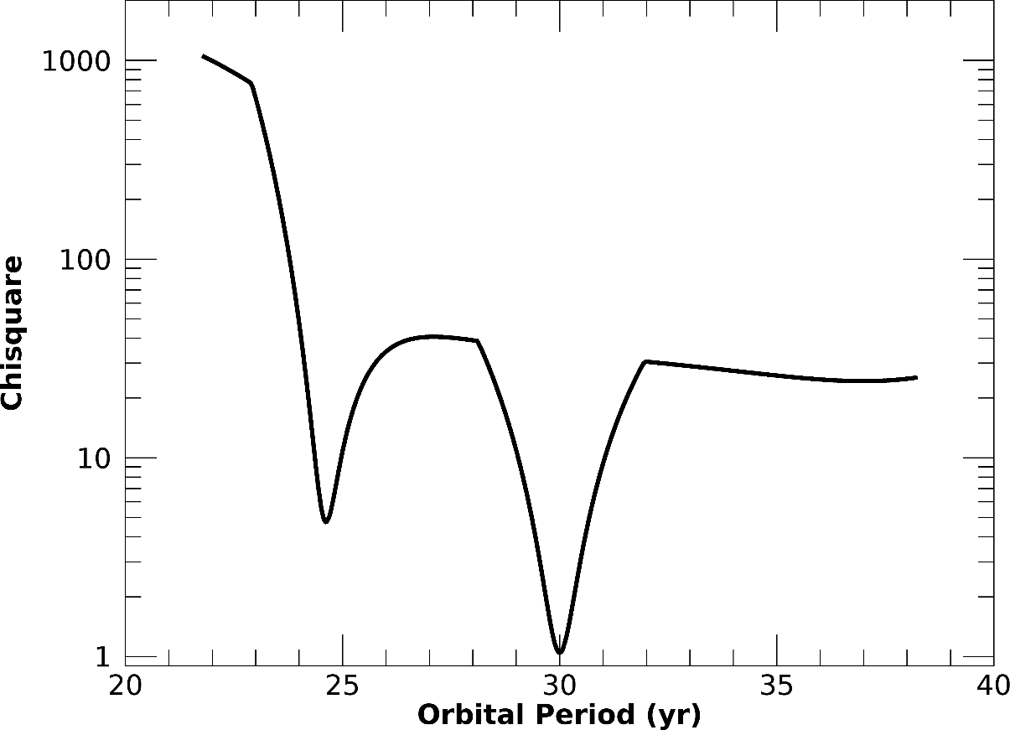
Gaia+GaiaNIR: Saturn-like orbits
1 M_{SUN} @ 30 pc
1 M_{Sat} planet
30-yr period
Averaging: e, T₀, i, Ω, ω
Gaia+GaiaNIR= 2x10-yr
- Robustness of orbit fitting algorithms a key
- Multiples a likely interpretative complications: to be investigated

Slide 21
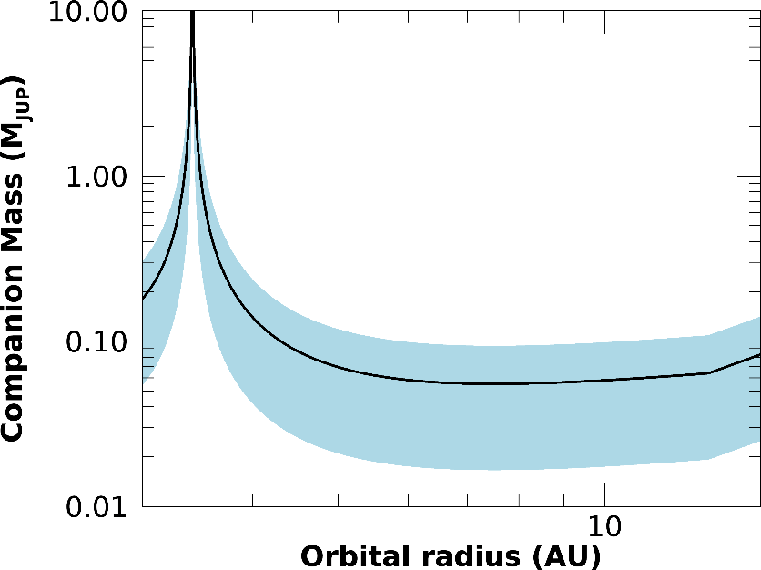
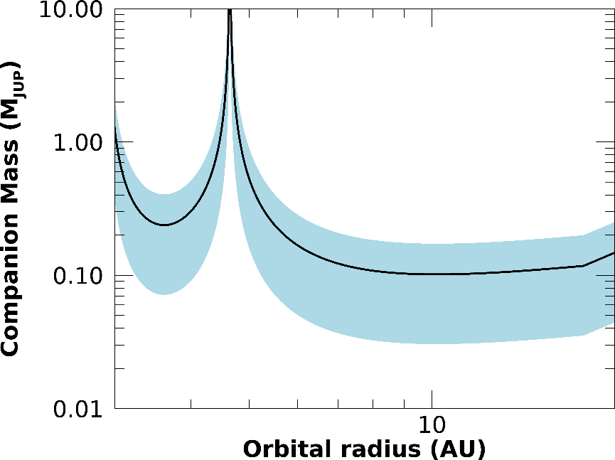
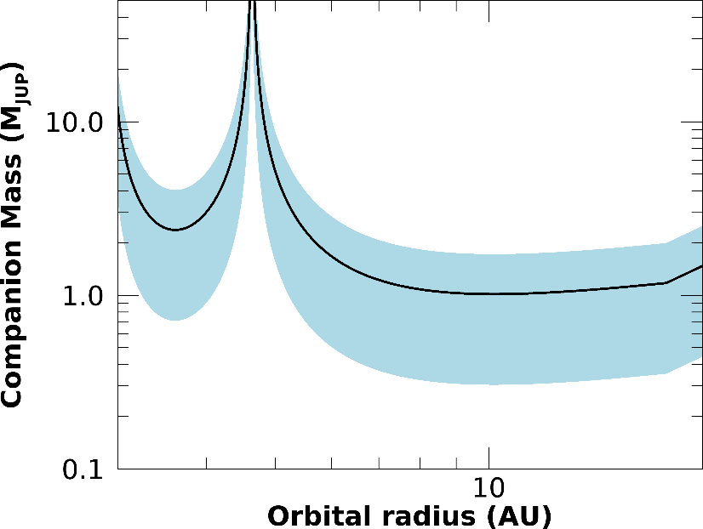
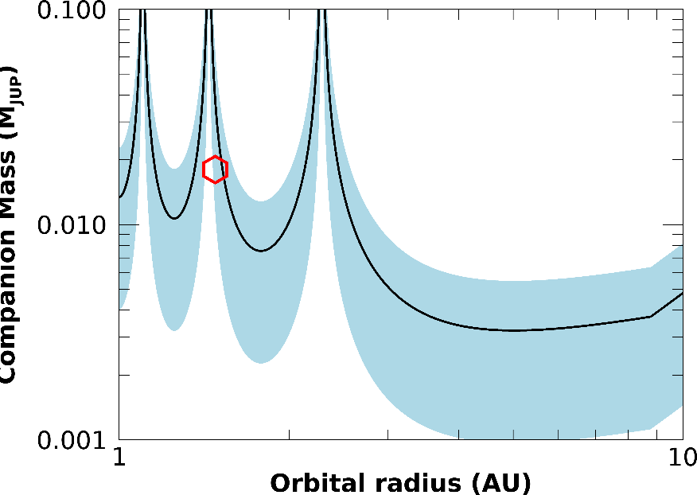
Gaia + GaiaNIR: PMA
0.4 M_{SUN} @ 10pc
1 M_{SUN} @ 10pc
1 M_{SUN} @ 100pc
Proxima

Slide 22
Synergies
Transit surveys, Kepler, TESS, PLATO:
Outer regions of transiting systems (ordered architectures,
coplanarity) -> Occurrence Rates, Demographics
RV surveys, sub-µas astrometry:
Outer regions of close-in, small RV planets (ordered architectures,
coplanarity, true masses) -> Occurrence Rates, Demographics
Direct imaging surveys (ground-based, Roman):
orbital architectures, masses -> Occurrence Rates, Demographics
Microlensing surveys (ground- and space-based):
concordance (or lack thereof) with occurrence rates of cold planets
around M dwarfs

